Slide 1
Vehicle Door Unlocking using Face Recognition on Raspberry Pi
Kunjal Agrawal – 02
Atman Naik – 05
Ayushi Khare – 07
Hiranmayee Sant – 20
Aslaan Mulla - 28
Guided by- Prof. Vijay Mane

Slide 2
TABLE OF CONTENTS
Title | Slide
Introduction | 3
AIM AND OBJECTIVE | 4
Tools | 5
Methodology | 6
Literature Survey | 7
Conclusions | 8

Slide 3
Introduction
Vehicle safety is a major concern in today’s world.
Unlocking using face recognition acts as a dual safety measure.

Slide 4
AIM AND OBJECTIVE
Aim:- To show implementation of face recognition system on raspberry pi
Objective:- To make a model for a car unlocking system.

Slide 5
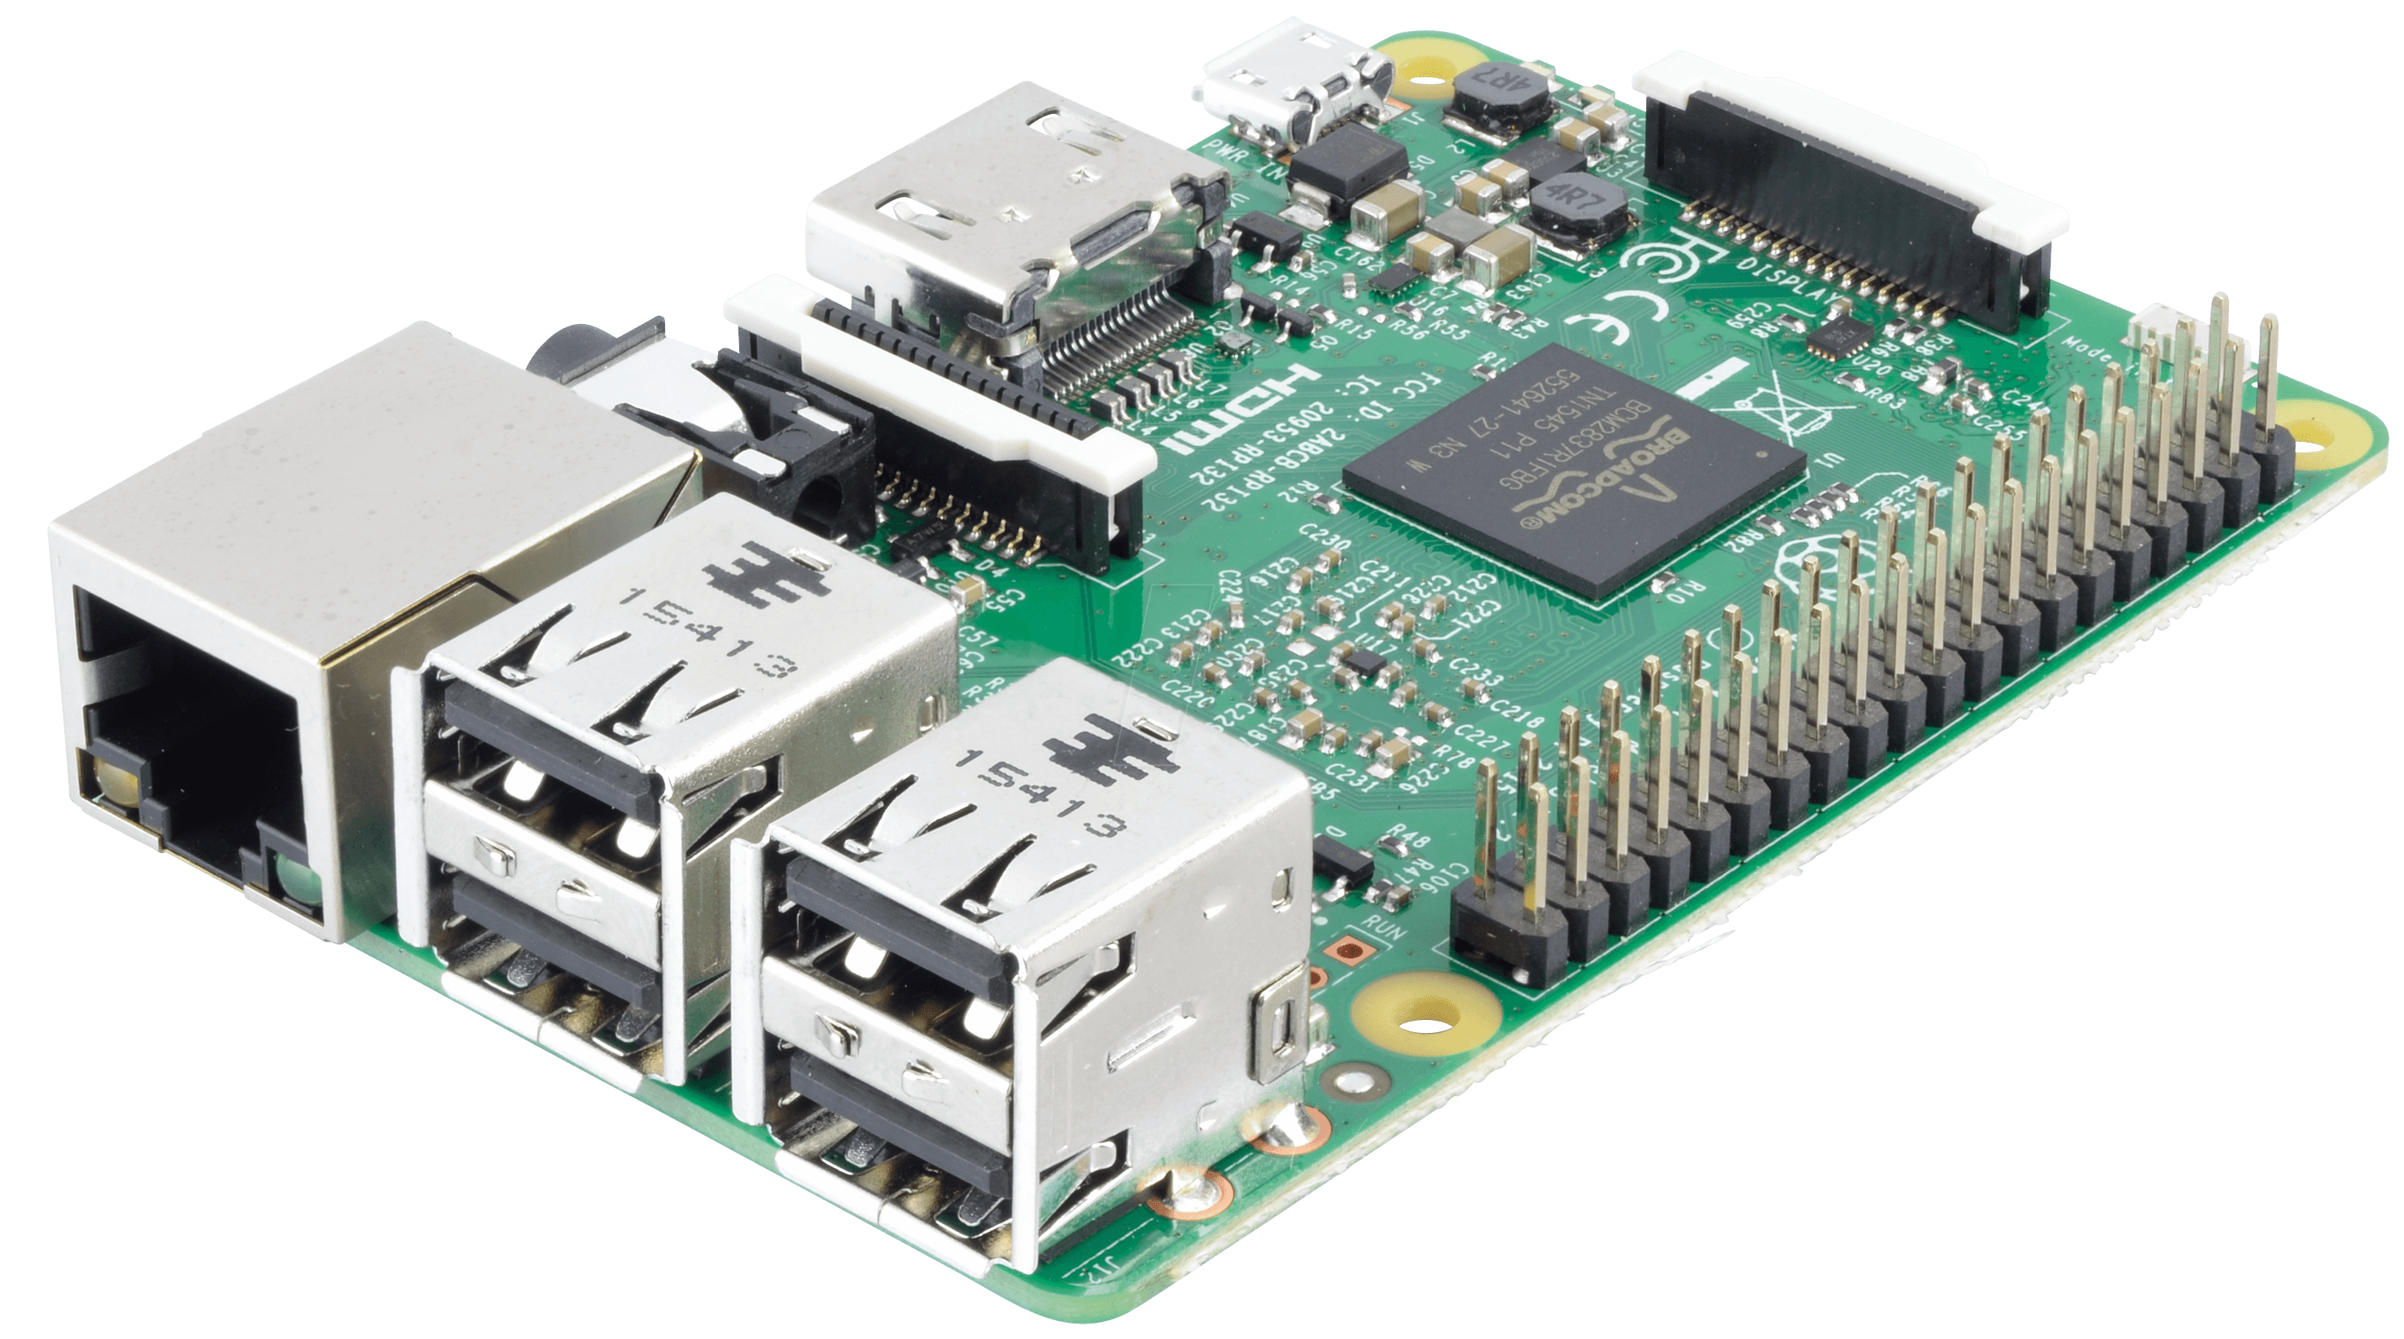

Tools
SOFTWARE
Coded in python,
Multiple Libraries used for training the data
HARDWARE
-Raspberry Pi-4
-5 volt relay
-9v dc motor
-Raspberry pi camera
-9v battery
-Different connecting wires- jumper cables

Slide 6
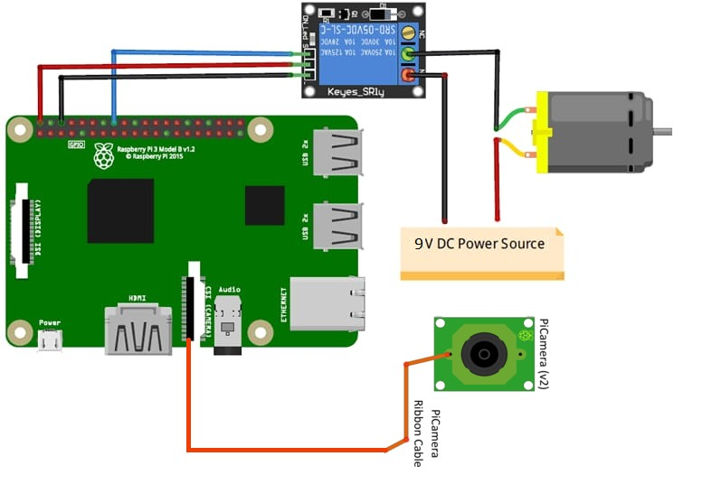
Methodology
Training the dataset of a person’s face for face recognition
The face person in front of the camera is then compared to the trained dataset
If the face matches, a positive is sent to the relay
This then triggers the motor and the door unlocks automatically

Slide 7
LITERATURE SURVEY
Title | Author | Abstract
Face recognition system with face detection | Ms. S. K. Ayesha | Detailed report on face detection and recognition
Face mask detection alert system using Raspberry Pi | G. V. Acharya | Real-time training and testing of face recognition
Raspberry Pi as internet of things hardware: performances and constraints | Vladimir Vujovic | Raspberry Pi is cheaper yet offers a lot of features which are enough for a detail analysis

Slide 8
Conclusion
The authorized person can be detected by the camera and the door unlocks automatically
This prevents theft of vehicles as unknown people can’t open the door to the vehicle

Slide 9
Thank You

